Slide 1


The EMP evaluation process
2010-2012
External Evaluator: Camilla Badstübner-Kizik
Institute of Applied Lingustics / Culture and Media Didactics in Foreign Language Teaching
University of Poznan, Poland

Slide 2

The EMP evaluation process
Evaluation Agenda
Evaluating the process of developing EMP
Evaluating the deliverables of EMP
Achievements
Problems / questions

Slide 3
1. Evaluation Agenda May 2010 – September 2012
Independant Consultant (02/10 – 11/10)
Call for bids (11/10)
Final evaluation plan / contract (01/11)
8 evaluation steps
1-3) Discussing & developing project deliverables
May 2010 – March 2011
    a) Project meetings
    b) MOODLE
4) Progress Report
March 2011
5-8) Piloting & reshaping project deliverables
April 2011 – June/July 2012
        a) Project partners - Pilot teachers
        b) Pilot teachers - Teachers
Final Report
October 2012

Slide 4
Teacher’s Handbook / Booklet, Pupil’s Music Portfolio,
Core activities / Activity database ,
Comenius CPD Courses/National EMP-L courses,
Project website / MOODLE,
Project Newsletters

Slide 5
2. Evaluating the process of developing EMP
Project meetings
    running of discussion / impact on deliverables
    actual project meetings
Online discussion
    activity
    display of results

Slide 6
a) Project meetings (SG + BE)
Place | Time | Feedback (number of responses)
DE Ochsenhausen | 10/09 (Kick off-meeting) | 17
GB Canterbury | 02/10 | 7
GB Edinburgh | 05/10 | 20
GR Athens | 11/10 | 14
RO Constanta | 04/11 | 8
ES Barcelona | 11/11 | 16
CH Schiers | 07/12 | 2

Slide 7
Feedback on project meetings
Running of discussion / impact on deliverables
+ gradually improving
+ (more or less) meaningful results
- vague / hardly comparable answers
Actual project meetings
  + creative atmosphere
  + place / contacts
  + improvement in communication & management
  high time pressure / tight schedule
  finances
  certain imbalance of activities

Slide 8
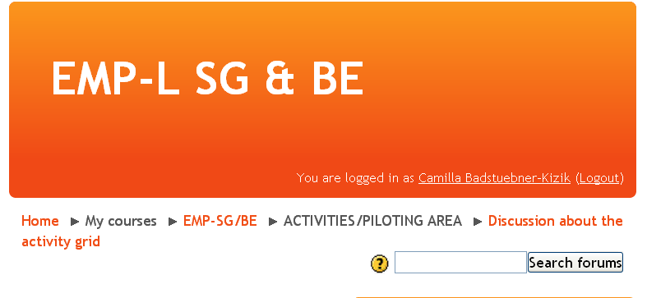
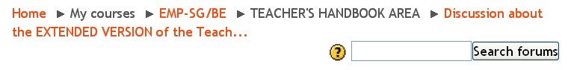
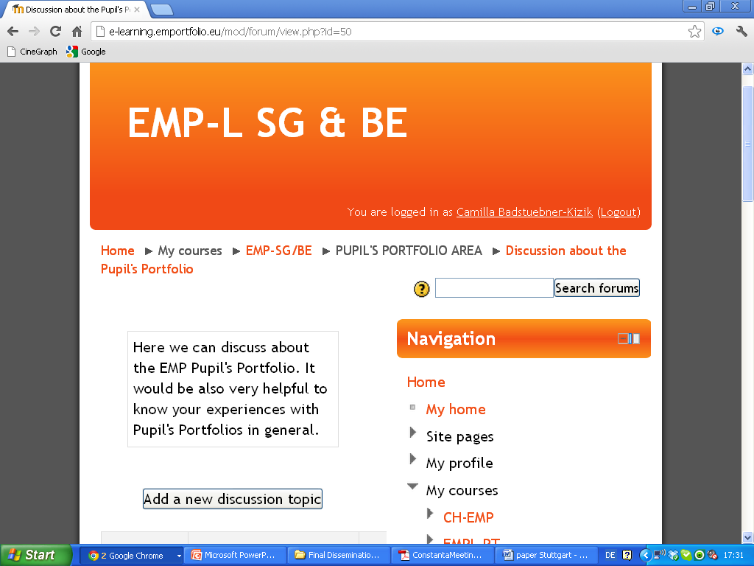
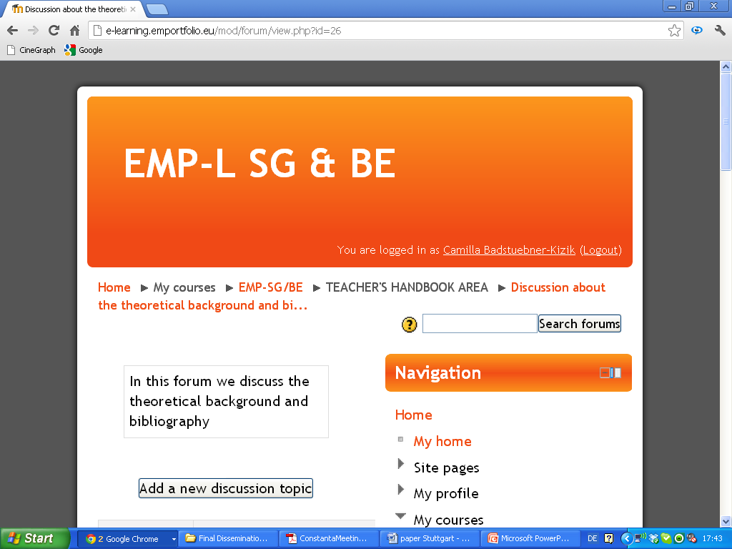
Developing AG, TH, PMP: online discussion
Main activities
10/2010 - 07/2011
AG: 2 responses
TH: 14 responses
PMP: 2 responses
Theoretical background: 1-2 responses

Slide 9
3. Evaluating the deliverables of EMP
Teacher’s Handbook / Teacher’s Booklet
Pupil’s Music Portfolio
Core activities / Activity database - MOODLE
Comenius CPD Courses / National EMP-L Courses
Project website / MOODLE
Project Newsletters (1-4)

Slide 10

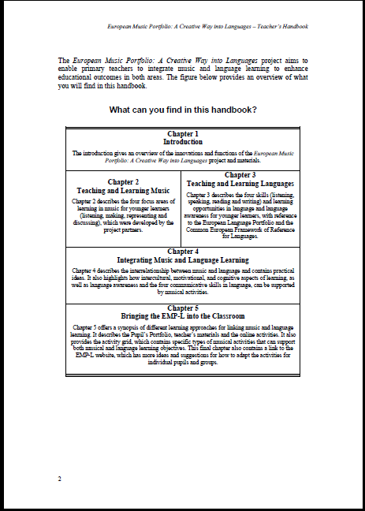
a) Teacher’s Handbook drafts 1-5 final version 02/12, booklets?

Slide 11
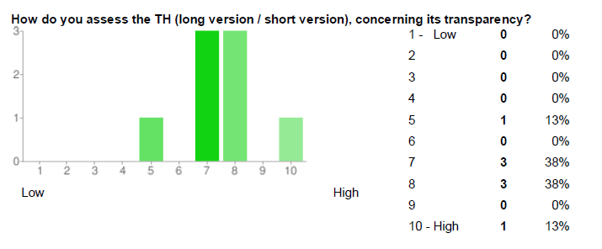
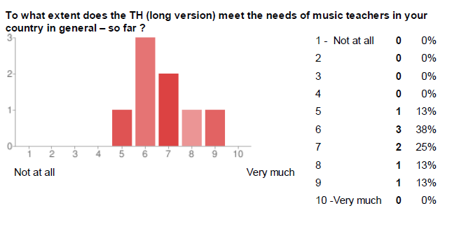
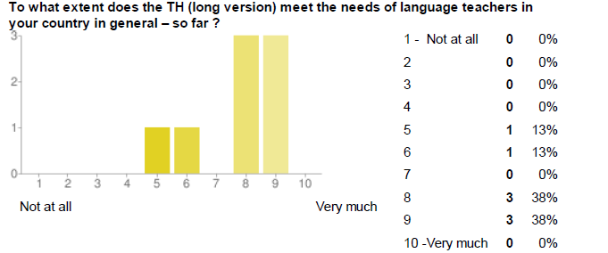
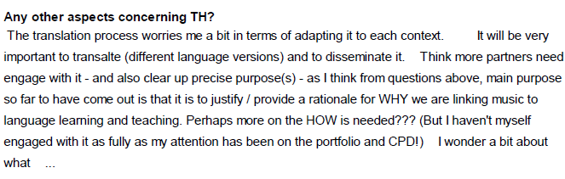
Developing the TH: project meeting RO, Constanta 04/11, 8 x
Completeness?
Transparency?
Comprehensiveness?
Linking S-P approach?
Needs of MT?
Needs of LT?
Missing?
Other aspects?

Slide 12
Feedback on TH
,outside’ feedback (9x)
+ Clear structured / comprehensive!
+ Easy to use / helpful!
+ Good link between theory and classroom work!
+ Inspiring creativity!
Summary / short version?
Balance between linguistic and musical aims and teaching competences?
Other languages than primary English?
Feedback from pilot teachers / teachers?
National language versions / booklets?

Slide 13
b) Pupil’s Music Portfolio several drafts final version 03/12
My Musical Journal
10 sections, 1-5 cards (46)
opportunities for musical / language learning
linking with TH, references to ELP
suggested extensions for (inter)cultural awareness
sample activities
suggested learning strategies
Music and me
12 cards (pupil’s and teacher’s cards), different activities
linking with TH and MMJ
suggested extensions for (inter)cultural awareness
sample activities
My Musical Treasure
sample card for portfolio

Slide 14
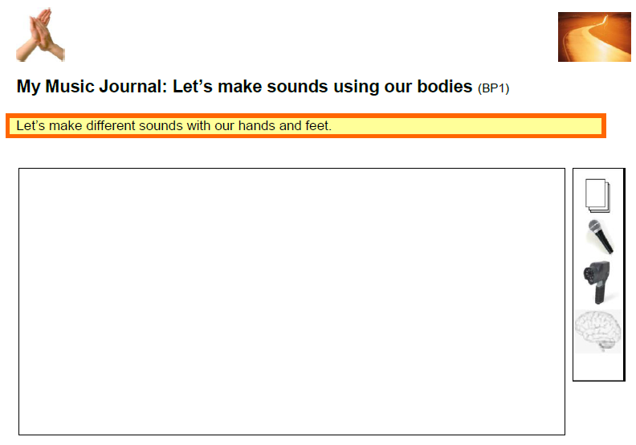
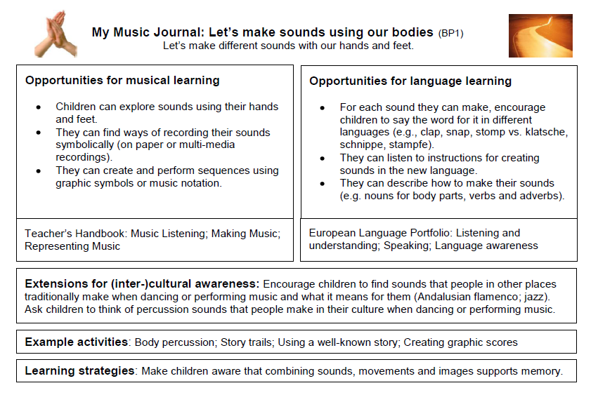
MMJ

Slide 15
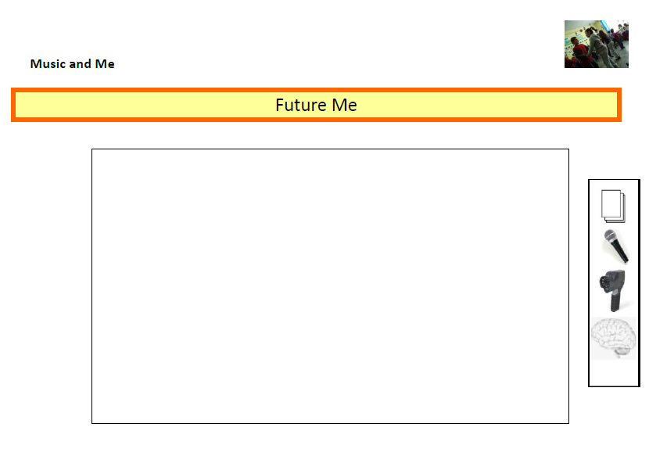
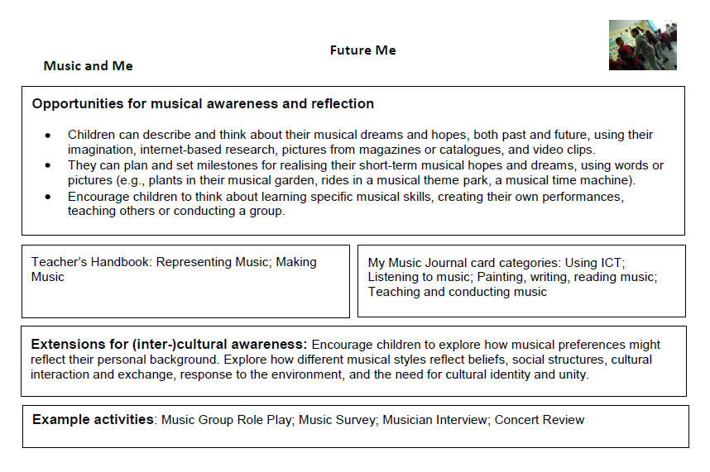
MaM

Slide 16
Feedback on PMP
06/12 – 09/12?
+ clear coherent structure and linking!
+ careful design!
+ main areas of activities covered!
+ inspiring creativity!
balance between musical and linguistic activities?
target group(s)?
  multilingual classroom in a second language setting?
  strong elements of CBLL and CLIL?
Teacher’s and pupil’s feedback?
Pupil’s portfolio cards in national languages?

Slide 17
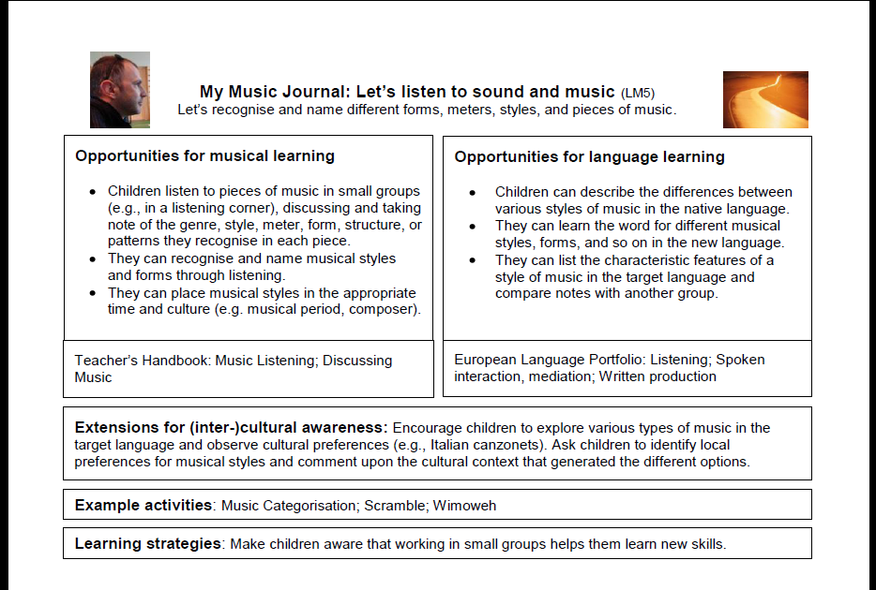


Slide 18
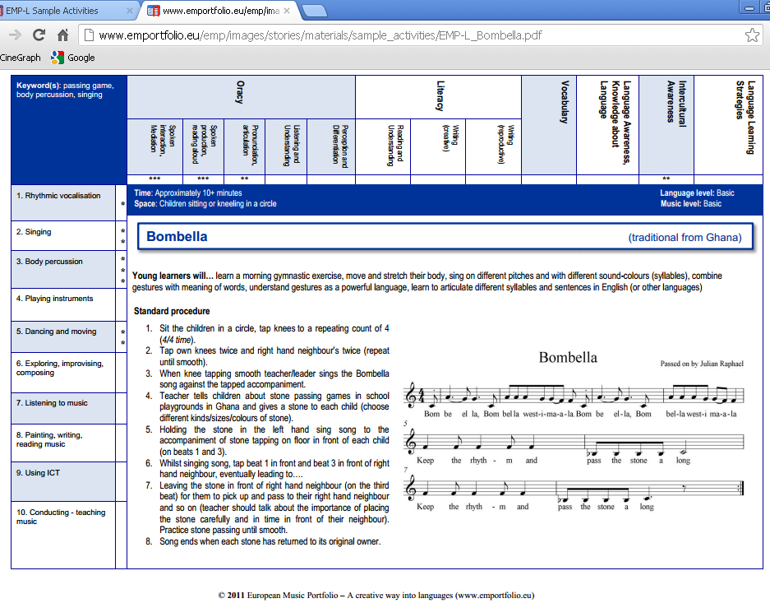
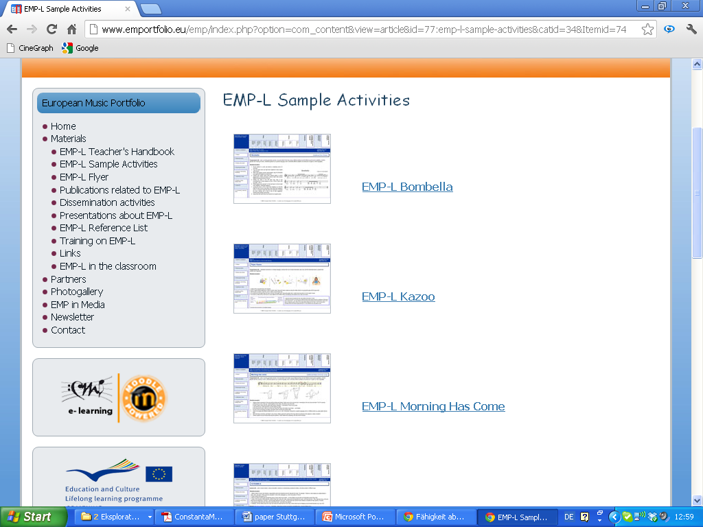
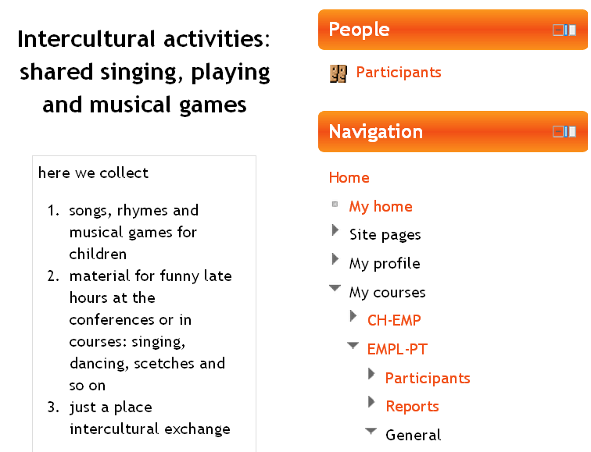
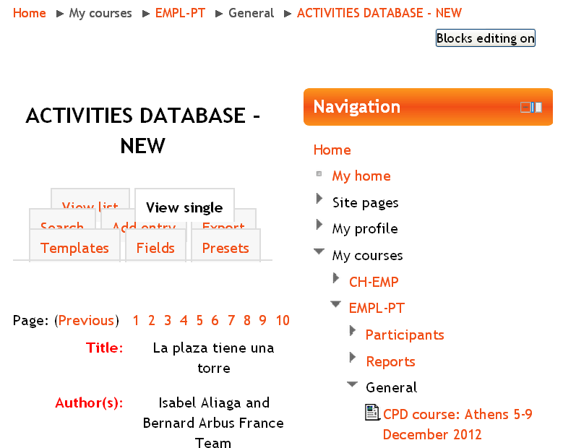
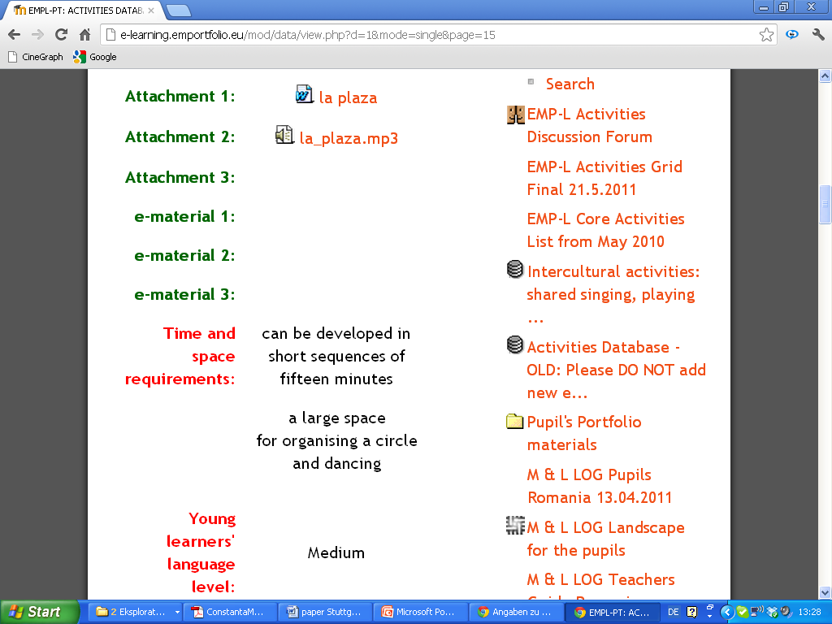
c) Core activities / Activities Database online
14/09/12
6 free
activities
about 100 activities with restricted access

Slide 19
d) Comenius CPD Courses / National EMP-L Courses
14/09/2012
CPD courses (members of BE/SG, multinational participants, 2,5-5 days stucture)
  2010: 1
  2011: 2
  2012: 10
  2013: 8
National EMP-L Courses (pilot teachers)
  2010: 3
  2011: 4
  2012: 7
  2013: 3

Slide 20
Feedback on CPD / EMP-L courses
Time | Place |  |  | Feedback (number of responses)
2010, 09/09 | DE, Suttgart | EMP-L |  | -
2010, 18/09 | GB, Edinburgh | EMP-L |  | -
2011, 26-28/04 | DE, Ochsenhausen |  | CPD | -
2010, 22/09 +11/11 +14/02 + 12/05 + 05/072012 | ES, Cerdanyola del Valles | EMP-L |  | -

Slide 21
Time | Place |  |  | Feedback (number of responses)
2011, 12/02 | GB, Edinburgh | EMP-L
2011, 14/02 +12/05 +05/07 | ES, Cerdanyola del Valles | EMP-L
2011, 04-06/04 | DE, Ochsenhausen | EMP-L |  | 12
2011, 24/05 | DE, Bad Saulgau |  | CPD
2011, 08/09 +26/10 +11/01 +08/03 +24/04 +04/07/2012 | ES, Cerdayola del Valles | EMP-L
2011, 09+16/11 + 08/02/2012 | DE, Stuttgart |  | CPD | 6

Slide 22
Time | Place |  |  | Feedback (number of responses)
2012, 12 /01 | DE, Stuttgart |  | CPD
2012, 18-22 /01 | DE, Ochsenhausen |  | CPD | 10
2012, 02+09/02 + 26/04 | FIN, Lahti | EMP-L | CPD | 4
2012, 05+09+30/03 | GB, Edinburgh | EMP-L
2012, 10/03 | CH, Aarau | EMP-L
2012, 12-14/03 | DE, Ochsenhausen |  | CPD | 7
2012, 24/03, 16/05, 13/06 | CH, Aarau | EMP-L
2012, 02+04+06/04 | RO, Constanta |  | CPD | 3
2012, 08/05 | DE, Nagold | EMP-L | CPD
2012, 23-25/05 | DE, Bad Wildbad |  | CPD | 16
2012, 19-24/06 | GB, Canterbury |  | CPD | 20
2012, 29-30/06 | GB, Edinburgh | EMP-L
2012, 08-13/07 | CH, Schiers |  | CPD | 8
2012, 03-08/09 | ES, Barcelona |  | CPD

Slide 23
Upcoming CPD / EMP-L courses
Time | Place
2012, 22/08 +14/11 +23/01 +13/03 2013 | CH, Aarau | EMP-L
2012, 22/09 +12/12 +16 /01 2013 | CH, Aarau | EMP-L
2012, 26/09 | DE, Stuttgart |  | CPD
2012, 22-16/10 | FR, Montpellier |  | CPD
2012, 25/10 | DE, Stuttgart / Esslingen |  | CPD
2012, 14/11 | DE, Stuttgart |  | CPD
2012, 05-09/12 | GR, Athens |  | CPD
2013, 06/02 | DE, Stuttgart | EMP-L | CPD
2013, 13-15/02 | DE, Bad Wildbad |  | CPD
2013, 20-22/03 | DE, Ochsenhausen |  | CPD

Slide 24
Feedback on CPD / EMP-L courses:
Canterbury (GB) 06/2012, Schiers (CH) 07/2012
+ (very) inspiring / positive experience
+ contacts
+ materials / ideas
tight schedule?
theory load?
unbalanced musical – linguistic input?
language choice?

Slide 25
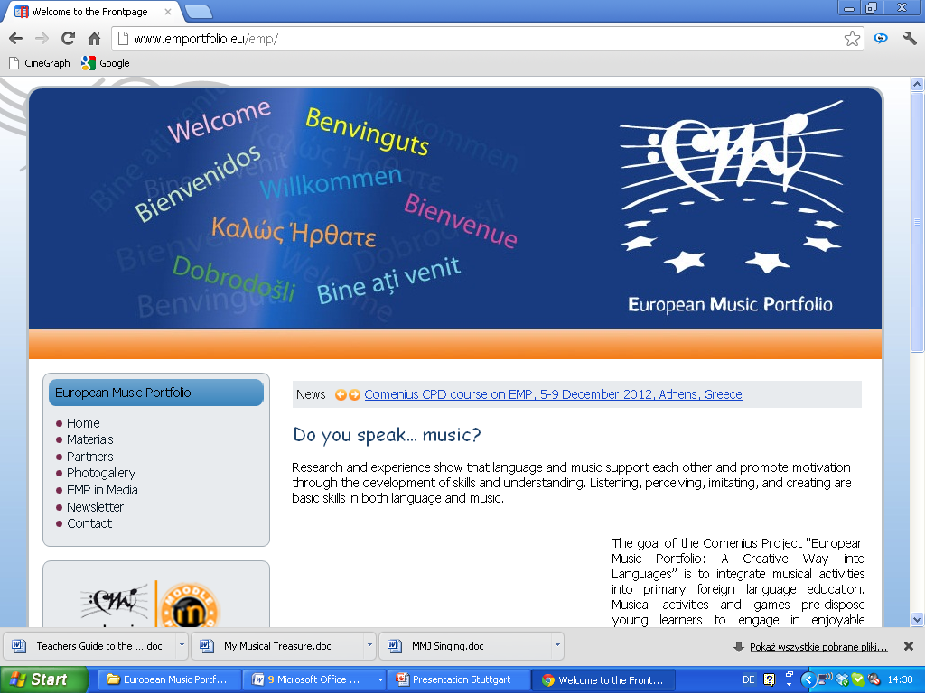
e) Project website / MOODLE

Slide 26
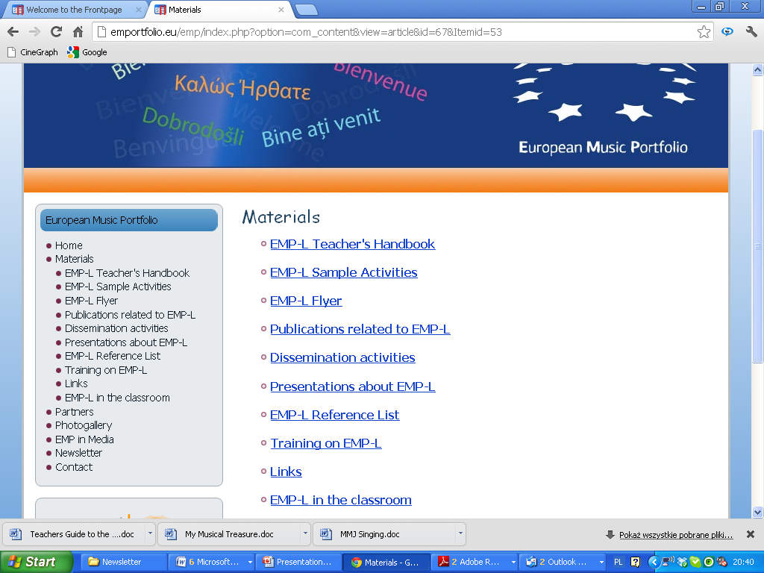
Open space
14/09/2012
- TH (+ PMP)
6 free activities
flyers in 8 languages
10 publications
congress Mannheim October 2011
Kick off-presentation, 19th EAS Conference
191 scientific references (03/2011)
training courses
EU report on Creativity and Innovation in Education (12/2010)
5 short sequences of rhythmic exercises in a German speaking EFL class

Slide 27

Restricted area
14/09/2012

Slide 28
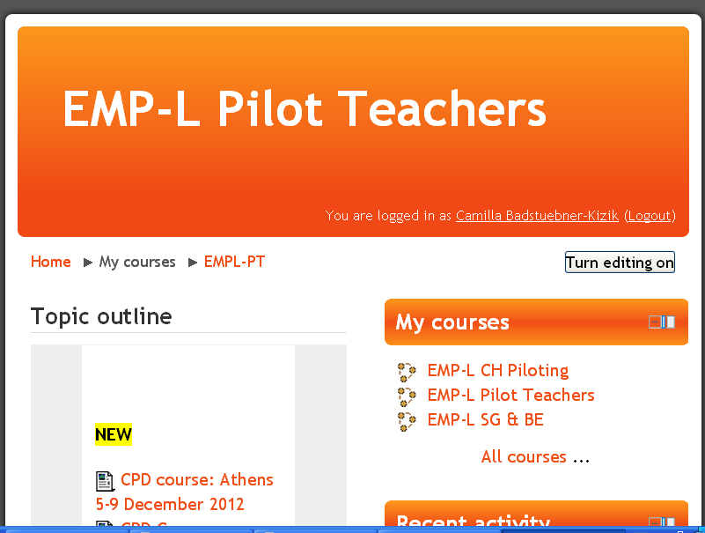
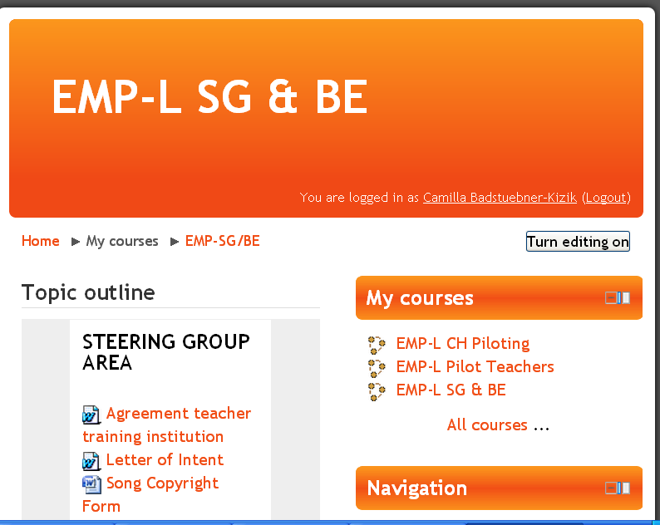
Restricted area
14/09/2012

Slide 29
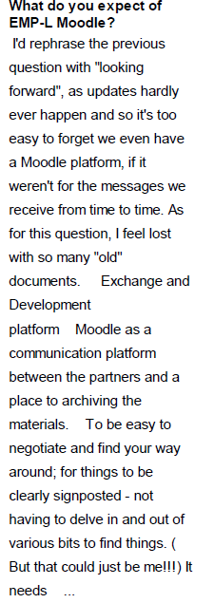
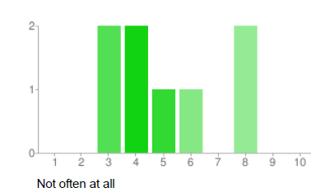
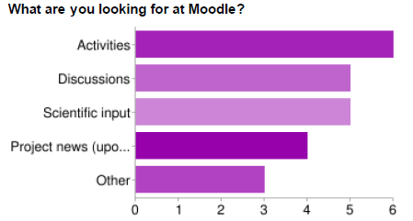
Feedback on project website occasionally from BE/SG project meeting RO, Constanta 04/11, 8 x
Frequency / aim of usage / expectations

Slide 30
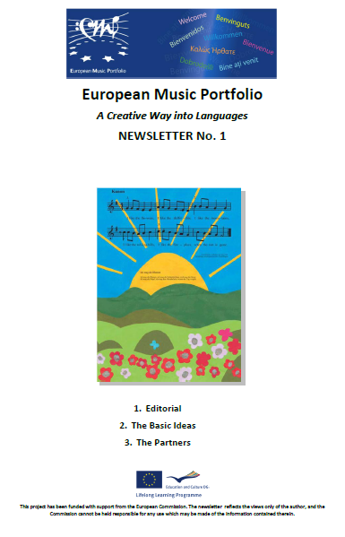
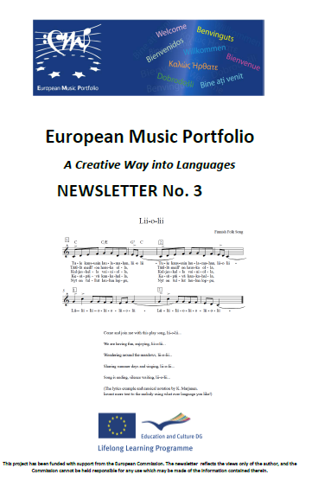
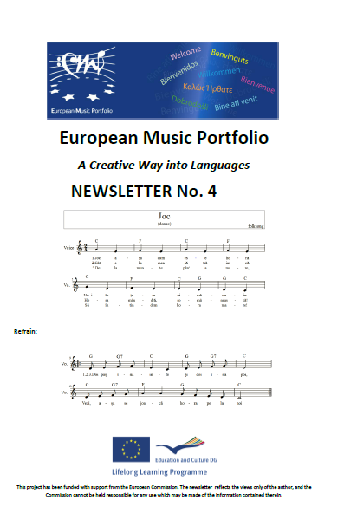
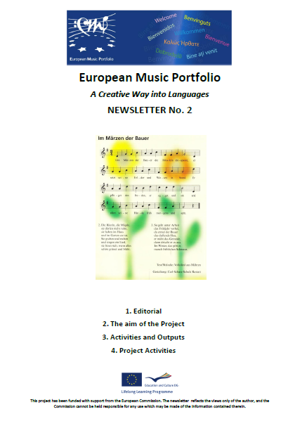
f) Project Newsletters
1 (03/12), 2 (04/12), 3 (08/12), 4 (09/12), upcoming 5+6

Slide 31
4. Achievements
5. Problems/questions
Professional networking
creativity
interdisciplinarity
Deliverables
close cooperation research-teaching
strong impulse for CPD
sound foundation for follow-up projects
TH / PMP: rich source for scientific evidence and its practical application: starting point / treasure chest
Issues of organisation
flow of communication
task allocation and coordination
online presence (public access, copyright …)
Issues of content
balance between Music and Foreign Language Teaching / Learning
clear target focus(es)
(inter)cultural / musical / linguistic cooperation between project partners on different levels

Slide 32
Thank you for your attention!

